Slide 1
Haematemesis and Malena
Dr Budhima Nanayakkara

Slide 2
Case 1
A 68yo male with a background of COPD and ischemic heart disease presents to the emergency department following a syncopal event after mobilising to the toilet. There was spontaneous recovery of consciousness. When the patient arrived at the emergency department his heart rate was 98, his blood pressure was 138 systolic and his respiratory rate was 28. Suddenly the emergency alarm goes off. Doc, this patient is bleeding out. You walk in to the resuscitation room and there is a streak of bloody vomit painted on the wall

Slide 3
Question 1
What is the major cause of acute upper gastrointestinal bleeding?
Gastroduodenal erosions
Oesophageal ulcers
Mallory weiss tears
Variceal hemorrhages
Vascular malformations
Peptic ulcers

Slide 4
Common causes of upper GI bleeding
Diagnosis | Approximate percentage
Peptic ulcer | 35 – 50%
Gastroduodenal erosions | 8 – 15%
esophagitis | 5 – 15%
Varices | 5 – 10%
Mallory Weiss tear | 15%
Upper Gastrointestinal malignancy | 1
Vascular malformation | 5

Slide 5
Acute assessment and management
Basic principles of intravascular volume loss
BP – hypotension implies about 20 – 25% loss of blood volume (significant)
Postural drop – will pick up 10 – 15% blood loss
Tachycardia – unless beta blocked
Airways – keep patent (aspiration risk, consider intubation to protect airways)
Breathing – oxygen to titrate saturations > 92%
Circulation – IV access x2 large bore cannulas for infusions of PPI/ octreotide and fluids/ blood products
Bloods taken: G+S/ FBC/ Coags/ UEC/ CMP/ LFT

Slide 6
Urea/ Creatinine
UEC: Urea:Cr ratio very helpful
If Urea elevated with normal Cr with clinical presentation then can clinch diagnosis of upper GI bleed
Other causes of elevated urea: Cr ratio include dehydration and drugs such as tetracyclines and prednisolone
Good for diagnostic uncertainty
Good for follow-up, as when patient has stopped UGIB, then urea levels normalsie after 48h

Slide 7
Acute Management
1 – 2 L Normal Saline to correct volume loss in most patients
If remain shocked, use blood products thereafter
Correction of coagulopathy if this is significant:
5-10mg IV Vit K + prothrombinex + FFP
Balanced against cardiovascular risk (eg AF/ mechanical valve) – general practice in significant bleeders is to stop their anticoagulation, correct any coagulopathy then restart after stable and risk of re-bleeding has been reduced
Platelet transfusions very rare: only if <50 and high risk patients (eg patients with poor quality platelets from BM suppression/ EtOH)
Variceal bleeders hardly get transfused because thrombocytopenia is secondary to sequestration

Slide 8
Question 2
You believe the cause of the syncope is GI bleed which lead to massive hematemesis. You have appropriately positioned the patient to avoid aspiration and have called the anaesthetics registrar for airway support. You aim to keep oxygen sats above 92 with supplemental oxygen. You have placed two large bore cannulas in the patient and have taken the bloods. You have given the patient one bag of normal saline STAT and noted that the pulse rate dropped post intervention. You have also initiated a PPI infusion (there is no history of chronic liver disease). The Haemoglobin comes back at 88. His Urea is 32, Creatinine is 93. Previous bloods show that his Urea was 6.8, Creatinine 72.

Slide 9
True or False
To achieve optimum delivery of oxygen we should aim to maximise hamaglobin levels?
Blood transfusion should occur in patients with Hb <70 AND in all high risk patients with active bleeding or haemodynamic compromise
Recombinant activated Factor VII has no role in patients with ongoing massive haemorrhage

Slide 10
Research Question
In patients with Upper GI Bleed, would a restrictive (transfuse if Hb < 70 and aim Hb 70 – 90) protocol be significantly different from a liberal protocol (transfuse if Hb < 90 and aim Hb 90 – 110) ?

Slide 11
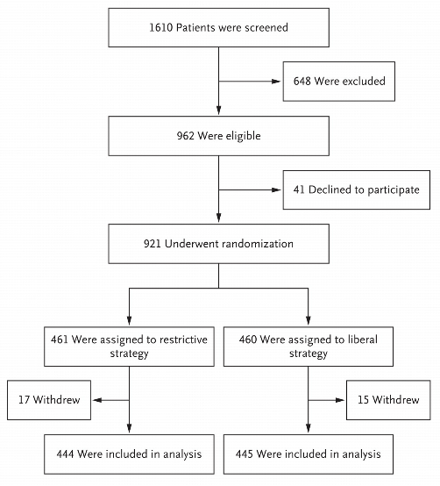
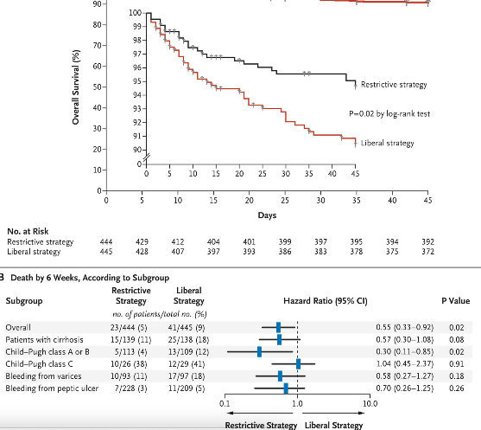
New England Journal of Medicine 2013; 368: 11 – 21

Slide 12
Why do Childs Pugh A/ B have much worse prognosis in liberal vs restrictive strategy?
? Increase in portal pressure

Slide 13
Question 3
The emergency physician calls the gastroenterology advanced trainee over the phone. In his quite relaxed state he casually explains “mate, we have an acute UGIB, we need you to scope the patient urgently, this patient has had a massive bleed”. You as the resident who is intricately involved in patient care ponders whether you should urgently scope this patient who has upper GI bleeding?
What factors would make this patient need to have an urgent scope?
Is there any benefit from waiting and stabilizing the patient for elective scope the next day?
Is there any utility in using nasogastric washout or promotility agents to improve visibility?
Notes:
Variceal bleed
Those not responding to 2L
Only 20% require

Slide 14
Endoscopy in H&M
Diagnostic
Prognostic
Forrest classification
Therapeutic
Reduces rebleeding
Reduces need for surgical intervention
mortality

Slide 15
Question 4
The Gastro AT informs his consultant. The consultant reckons that, given the patient is currently haemodynamically stable and has had no further episodes of haematemesis, we could hold of on endoscopy until the next day. The patient is bed booked under gastro and is awaiting a bed in the wards. His Hb has not dropped on repeat bloods but his Urea/Cr remain elevated (creatinine having normalised with fluids). The gastro AT quizzes you, he having just passed his BPT exams.

Slide 16
Question 4
Is there any mortality benefit in using proton pump inhibitors prior to endoscopy?

Slide 17
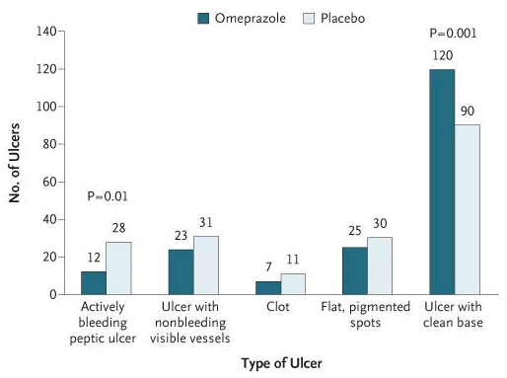
Omeprazole before endoscopy in patients with gastrointestinal bleeding NEJM 2007; 356: 1631 – 1640

Slide 18
Over a 17-month period, 638 patients were enrolled and randomly assigned to omeprazole or placebo (319 in each group). The need for endoscopic treatment was lower in the omeprazole group than in the placebo group (60 of the 314 patients included in the analysis [19.1%] vs. 90 of 317 patients [28.4%], P=0.007). There were no significant differences between the omeprazole group and the placebo group in the mean amount of blood transfused (1.54 and 1.88 units, respectively; P=0.12) or the number of patients who had recurrent bleeding (11 and 8, P=0.49), who underwent emergency surgery (3 and 4, P=1.00), or who died within 30 days (8 and 7, P=0.78). The hospital stay was less than 3 days in 60.5% of patients in the omeprazole group, as compared with 49.2% in the placebo group (P=0.005). On endoscopy, fewer patients in the omeprazole group had actively bleeding ulcers (12 of 187, vs. 28 of 190 in the placebo group; P=0.01) and more omeprazole-treated patients had ulcers with clean bases (120 vs. 90, P=0.001).

Slide 20
Results
Outcome | Control | PPI | Confidence interval
Mortality | 6.1% | 5.5% | 1.1 [0.72 – 1.73]
Rebleeding | 16.6% | 13.9% | 0.81 [0.61 – 1.09]
Surgery | 10.2% | 9.9% | 0.96 [0.68 – 1.35]
Stigmata of Recent Hemorrhage | 46.5% | 37.2% | 0.67 [0.54 – 0.84]
Endoscopy Therapy requirement | 11.7% | 8.6% | 0.68 [0.5 – 0.93]

Slide 21
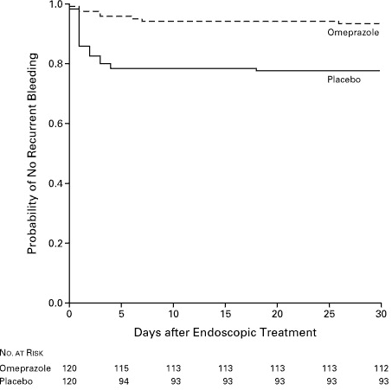
Effect of Intravenous Omeprazole on Recurrent Bleeding after Endoscopic Treatment of Bleeding Peptic Ulcers
James Y.W. Lau, M.B., B.S., Joseph J.Y. Sung, M.D., Kenneth K.C. Lee, Ph.D., Man-yee Yung, B.N., Simon K.H. Wong, M.B., Ch.B., Justin C.Y. Wu, M.B., Ch.B., Francis K.L. Chan, M.D., Enders K.W. Ng, M.B., Ch.B., Joyce H.S. You, Pharm.D., C.W. Lee, M.Phil., Angus C.W. Chan, M.B., Ch.B., and S.C. Sydney Chung, M.D.
N Engl J Med 2000; 343:310-316
Regime tested: 80mg STAT then 8mg/hr for 72 hours post endoscopic treatment of high risk ulcers
Conclusion: After endoscopic treatment of high-risk ulcers, PPI reduced risk of re-bleeding and decreased need for blood transfusion and hospital stay

Slide 22
Am J Gastroenterol. 2008 Dec;103(12):3011-8. High- versus low-dose proton pump inhibitors after endoscopic hemostasis in patients with peptic ulcer bleeding: a multicentre, randomized study.
Andriulli A1, Loperfido S, Focareta R, Leo P, Fornari F, Garripoli A, Tonti P, Peyre S, Spadaccini A, Marmo R, Merla A, Caroli A, Forte GB, Belmonte A, Aragona G, Imperiali G, Forte F, Monica F, Caruso N, Perri F.
High-dose treatment = 80mg PPI → 8mg/hr 72/24
Standard therapy = 40mg daily for 3/7
Only significant difference was 5/7 hospital stay
Cochrane 2013: “There is insufficient evidence for concluding superiority, inferiority

Slide 23
Question 5
The next day the patient is fasted and consented for endoscopy. You have changed rotation and are now the gastro resident. Your consultant wants you to accompany the patient and watch the procedure. You have a feeling that he is going to ask you about ulcer morphology and risk of re-bleeding.
Name some morphological appearances of ulcers that predict re-bleeding rate

Slide 24
Stigmata | Risk of rebleeding without therapy
Active arterial (spurting) bleeding | 100%
Non-bleeding visible vessel | 50%
Non-bleeding adherant clot | 30 – 35%
Ulcer oozing | 10 – 27%
Flat spot | <8%
Clean-based ulcers | <3%
Rx

Slide 25
Endoscopic treatment available
Inj 1:10000 adrenaline
Not used by itself as effect wears out
Coagulation therapy
Heat therapy or electrocautery
Endoscopic clip
Useful for brisk bleeders – small arteries and arterioles
Usually need multiple clips on the arterioles, average 3-4
Combination therapy
Adrenaline + others
If clot found in ulcer, remove clot first then treat the ulcer

Slide 26
Case 2
A 52yo female patient presents with massive UGIB. Her Hb is 68, she is tachycardic and hypotensive. She immediately receives volume resuscitation and blood products. Her history is significant for alcoholic liver disease and Hepatitis C. She is Childs – Pugh B cirrhosis. Her previous admission was complicated by hypervolemic hyponatreamia and ascites. Her serum albumin to ascites gradient was 16 giving further evidence to portal hypertension. Her screening gastroscope showed evidence of hypertensive portal gastropathy. She is on spironolactone 200mg daily and frusemide 80mg daily.

Slide 27
Question 1
What is the mechanism of her hyponatraemia?
What is the treatment for hyponatraemia in this patient?

Slide 28
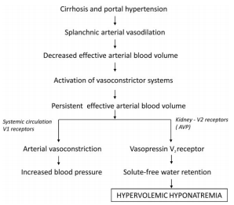

Slide 29
Significance of hyponatraemia
Independent predictor of prognosis
Some believe of the utility of MELD-Na score
Associated with refractory ascites, spontaenous bacterial peritonitis and hepatic encephalopathy
Study in 2006 showed that in 997 cirrhotic patients, prevalence of [Na] < 130mM = 21.6%
Hepatic encephalopathy OR 3.4 [2.35 – 4.92]
Correlated with decreased level of brain osmolyte myo-inositol and increased astrocyte swelling
Hepatorenal syndrome OR 3.45 [2.04 – 5.84]
SBP OR 2.36 [1.4 – 3.93]

Slide 30
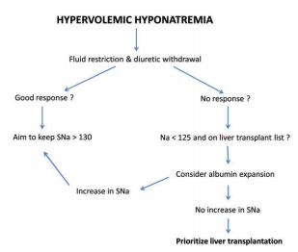

Slide 31
Role for V2 receptor antagonists (vaptans)?
SALT1 and SALT2 trials
Tolvaptan trialled
Significant improvement and normalisation of [Na] p = 0.001
Subgroup analysis showed significant increase in free water clearance associated with weight loss and normalisation of [Na] >135
Secondary analysis → improvement in health related quality of life scores in group Rx with tolvaptan
Hyponatraemia reliably recurs after discontinuation of treatment
Another large multi-centre trial showed that there was a significant elevation of liver enzymes
Other trials – Metanalysis (2012): total of 2266 patients with studies on tolvaptan, satavaptan and lixivaptan.
No difference in mortality, variceal bleeding, hepatic encephalopathy, SBP, hepatorenal syndrome or renal failure
Increased serum sodium levels, reduced weight and time to first paracentecis
Increased thirst and increased urine output

Slide 32
Case 2 continued
The emergency physician rings the consultant gastroenterologist and advices that this patient is a likely variceal bleeder and remains hypotensive despite fluid therapy and blood products. The ED doc and gastro doc debate the use of medical therapy prior to endoscopy, although they both agree that early endoscopy is important
What initial medical therapy would we consider in a patient with a suspected variceal bleed?

Slide 33
Medical therapy with octreotide
Somatostatin analogue, thought to decrease portal pressure
Given as an infusion rate of 50mcg/hr for 5 days (some centres will stop after 3/7)
Cochrane review 2007
No reduction in mortality
Reduction in rebleeding is variable and was not seen in high quality trials
Not many trials exist
Slightly reduced number of patients failing initial haemostasis
Trend towards reduction in blood transfusion requirements

Slide 34
Medical treatment with terlipressin
Synthetic vasopressin analogue
1-2mg IV bolus 4 – 6 hourly for 2 – 5 days
Cochrane review 2007
Very poor quality trials
Reduction in mortality
Much more expensive
No difference compared with octreotide
Significant side effect of peripheral vasoconstriction and can cause ischaemic limb, gut, worsening of coronary artery disease
In TCH → usually not used in variceal bleeders
Use has been in patients with hepatorenal syndrome
? Pathophysiological basis for use

Slide 35
Medical treatment with antibiotics
Always use IVAbx
Mainly used ceftriaxone or quinolones
Dose interval from 1 – 10 days
Usually determined by time when stop bleeding
Significantly reduces mortality compared to placebo or no treatment – Cochrane 2007
Decreases other common infections: UTI, pneumonia

Slide 36
Endoscopic treatment (oesophageal varices)
Oesophageal banding
Better than injection sclerotherapy
Used for bleeding and non-bleeding varices

Slide 37
Oesophageal varices – secondary prophylaxis
Generally try and introduce propanalol (non selective beta blocker) once haemodynamically stable
Problem: tolerating low BP (usually have low BP), only 50% can use them
Mortality benefit and significantly reduces rebleeding
Patients who have had Varices we must offer subsequent endoscopic banding sessions every 2 – 3 weeks until eradication of varices
Shown to reduce rebleeding and mortality

Slide 38
Question
What are the other options that you could offer a patient if initial banding of oesophageal varices is unyielding?

Slide 39
If banding not possible:
Repeat endoscopy unless impossible
Sengstaken baloons – baloon tamponade at level of stomach
Leave overnight or max 24 hours, only temporary, scope next day
Can be chucked in ED
TIPS procedure
Radiological procedure, similar to surgical shunting
Go through jugular vein into hepatic vein, then through liver substance and find branch of protal vein, connect the two via metal stent
RISK: encephalopathy because of shunting of toxins directly to brain, 30 – 40% patients get encephalopathic, some intractable
RISK of worsening liver disease
Lactulose → lactulose + rifaxamin → narrow TIPS
Surgery – never really trialed, mortality is so significant

