Slide 1
Data Interpretation - a focus on ABGs
Dr Budhima Nanayakkara
MBBS

Slide 2
Ordering a test
Before you order a test, assume you know the result
Test should only confirm/ refute/ prognosticate
In essence, only order a test if you think it will change management
You are responsible for all tests ordered

Slide 3
Case 1
A 46yo female post allogeneic stem cell transplantation for multiple myeloma presents with progressive chest pain, chills and a yellow productive cough. Examination reveals a cachectic female with saturations of 96% on 8L HM, RR 32, PR 128, T 38.3C. Auscultation of the lungs reveals decreased air-entry on the left lower zone with bronchial breathing and inspiratory crackles

Slide 4
Case 1
The ED nurse performs an arterial blood gas sample for you

Slide 5
Case 1
Variable | Measured | Reference
pH | 7.48 | 7.35 – 7.45
pCO2 | 28 mmHg | 35 - 45
pO2 | 72mmHg | 70 - 100
HCO3 | 21mM | 22 – 26mM
BE | +2.4 | -3 to + 3
lactate | 1.8 | <2 mM
What is the abnormality here?
How do you explain this abnormality in terms of what you think is going on?

Slide 6
ABG interpretation
Why?
Rapid diagnosis
Ventilation disturbances
Acid-base disorders
General approach
Acidaemia vs alkalaemia
Ventilation abnormalities
compensation

Slide 7
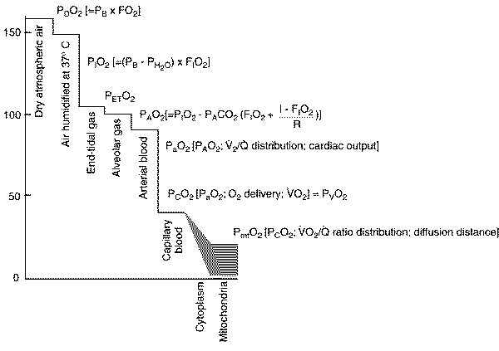

Slide 8
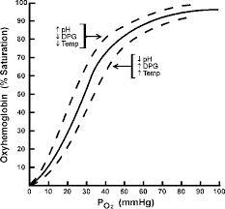
Part 1: Disorders of Ventilation (oxygenation)

Slide 9
Delivery of oxygen
Delivery of oxygen = arterial oxygen content x
cardiac output

Slide 10
Delivery of oxygen
Arterial oxygen content
Hemoglobin concentration
Causes of anaemia
Causes of abnormal haemoglobin
Saturation of haemoglobin
Dependent on pO2 and relationship with oxy-hemoglobin curve
pO2 dependent upon
Ventilation
Matching ventilation with perfusion
Diffusion
Other gases that take up room
Dissolved oxygen
Solubility co-efficient = 0.003
Unimportant physiologically

Slide 11
Cardiac Output
Stroke volume
Preload
End-diastolic volume
Compliance
frank-starling curve
Afterload
Laplace law
Contractility
Inotropic effects
Intracellular calcium

Slide 12
Cardiac Output
Heart rate
Autonomic stimuli
Pacemaker intrinsic rhythmicity
Arrythmias
Brady
Tachy
But heart rate and stroke volume are also related to each other

Slide 13
A-a gradient
The difference between alveolar oxygen and arterial oxygen
Alveolar oxygen must be inferred
Can be calculated easily

Slide 15
A-a gradient
PAO2 = FiO2(P(atm) – P(H2O)) – PaCO2/R
Most cases, let R = 0.8, P(atm) = 760mmHg, P(H2O) = 42mmHg

Slide 16
Interpretation of A-a gradient
The presence of a high A-a gradient implies the presence of intrapulmonary pathology
Pus, water, blood in alveoli
Pneumonia, pneumonitis, mucus plugging,
Diffusion defect in alveoli
Perfusion defect (local, systemic)
Normal = <15

Slide 17
Case 1:
Variable | Measured | Reference
pH | 7.48 | 7.35 – 7.45
pCO2 | 28 mmHg | 35 - 45
pO2 | 72mmHg | 70 - 100
HCO3 | 21mM | 22 – 26mM
BE | +2.4 | -3 to + 3
lactate | 1.8 | <2 mM

Slide 18
Case 1
Respiratory alkalosis
Hypoxia with increased A-a gradient
PaO2 = 72mmHg
FiO2 = 0.6
PAO2 = 0.6(760 – 42) – 28/0.8
PAO2 = 430.8 – 35
PAO2 = 395.8
A-a = 395.8 – 72mmHg
A-a = 328.8 mmHg

Slide 19
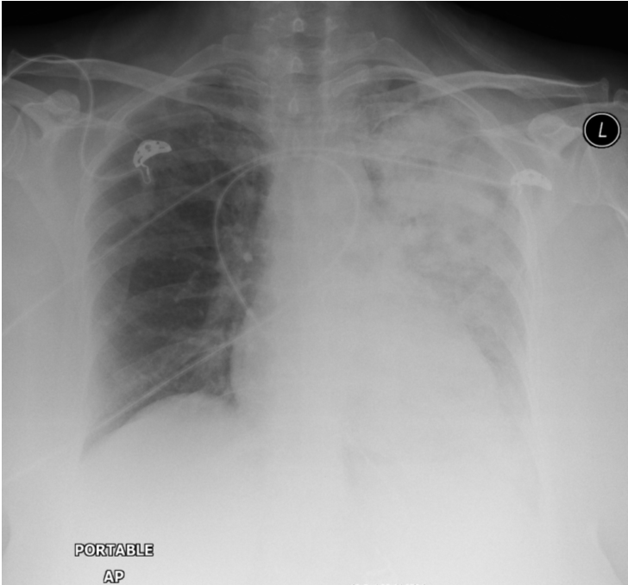

Slide 20
Respiratory failure
Type 1 respiratory failure
Hypoxia without hypercapnea
Type 2 respiratory failure
Hypoxia with hypercapnea

Slide 21
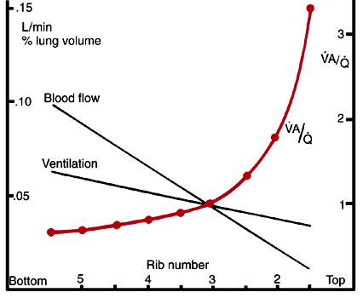
Concept of V/Q

Slide 22
Concept of V/Q
RV
RV
V/Q = 1
V/Q = 1
75%
75%
100%
100%
LA

Slide 23
Dead space ventilation
RV
RV
75%
V/Q = ++
V/Q = 1
75%
75%
100%
LA

Slide 24
Dead space ventilation
RV
RV
75%
V/Q = ++
V/Q = 1
75%
Increased oxygen
75%
100%
LA

Slide 25
Shunt
RV
RV
0
V/Q = 1
Increased oxygen does not help because V/Q units already saturated
Pulmonary arteriolar vasoconstriction
LA

Slide 26
Case 2
Met Call ward 6A Canberra Hospital. You attend to see a 94yo female, admitted for infective bronchiectasis, no other known co-morbidities. She is in severe respiratory distress with peripheral + Central cyanosis. JMO 30 minutes ago prescribed 5mg temazepam over phone order

Slide 27
Case 2
Variable | Measured | Reference
pH | 7.02 | 7.35 – 7.45
pCO2 | 128 mmHg | 35 - 45
pO2 | 72mmHg | 70 - 100
HCO3 | 38mM | 22 – 26mM
BE | +2.9 | -3 to + 3
lactate | 2.6mM | <2 mM

Slide 28
CO2 – Ventilation relationship
CO2 is inversely related to ventilation
Ventilation dependent on
RR
Central nervous system
Peripheral nervous system
NMJ
Diaphragm
Tidal volume
Chest wall compliance – including burns to skin
Lung compliance
Pleura
Diaphragm (including workload – such as exhaustion in asthma and COPD)
Dead space volume
Additional respiratory circuits
Pulmonary pathology
V = RR . (Vt – Vd)

Slide 29
Case 3
You are the ICU registrar who has been called in to A and E to assess a patient for ICU. There is a 32yo female, unconscious and tubed. An Abg has been performed

Slide 30
Case 3
Variable | Measured | Reference
pH | 7.20 | 7.35 – 7.45
pCO2 | 20 mmHg | 35 - 45
pO2 | 180mmHg | 70 - 100
HCO3 | 18mM | 22 – 26mM
BE | +2.4 | -3 to + 3
lactate | 1.8 | <2 mM
Na+ | 140 | 135 – 145mM
K+ | 4 | 3.5 – 5.2mM
What is the acid base disorder
Calculate the anion gap

Slide 31
Metabolic acidosis
CO2 + H2O H2CO3 H+ + HCO3
Le-chatelier’s principle: Any perturbation to the system results in the system attempting to restore equilibrium
This explains why CO2 produces acidocis
This explains why decreased HCO3 produces acidocis

Slide 32
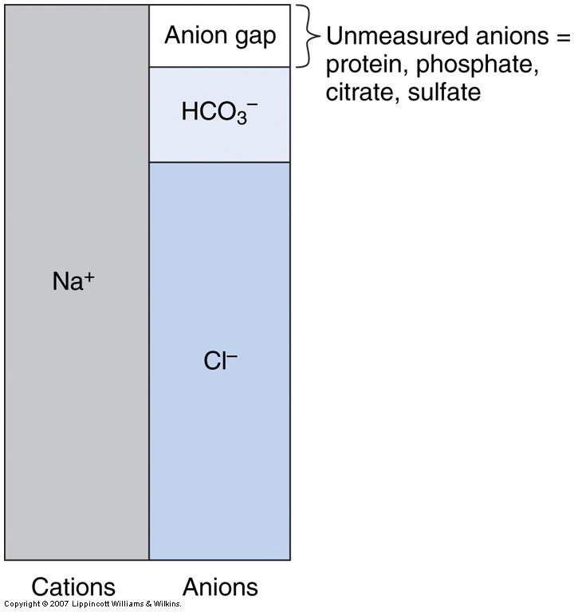
Approach to metabolic acidosis
Anion gap (RAGMA) vs non-anion gap (NAGMA)

Slide 33
RAGMA
MUDPILES
M – Methanol
U – Uraemia (renal failure)
D – DKA, alcoholic ketoacidocis, starvation ketoacidocis
P – para-aldehyde
I – isoniazid, iron
L – lactic acidocis (Type A and Type B)
E – ethylene glycol
S – salicylates

Slide 34
Osmolar Gap
To further investigate RAGMA, we can
Measure lactate
BGL
Ketones
Osmolar gap
Measured osmolality (freezing point depression) – calculated osmolality (2.Na + urea + glucose)
If >10, implies that there is a significant unmeasured anion present

Slide 35
NAGMA
Increased H+
TPN solutions, HCl ingestion
HCO3 loss
Renal
Renal tubular acidocis
Acetazolamide
GI
Diarrhoea
Urinary diversion
Small bowel fistula

Slide 36
NAGMA and RAGMA co-exist
Delta gap:
Allows for the partitioning of metabolic acidosis into a RAGMA component and NAGMA component
Derived from the fact (and assumption) that in a pure anion gap metabolic acidocis, the increase in anion gap (delta AG) is equal to the decrease in bicarbonate (delta bicarb)
If delta bicarb decreases much more than delta AG, then there is evidence for both a RAGMA and NAGMA
For example a lactic acidosis with renal tubular acidosis

Slide 37
Case 4
48yo female who loves licorice presents with nausea and vomiting that is intractable. She is hypotensive and tachycardic on arrival. A VBG is obtained prior to further resuscitation.

Slide 38
Case 4
Variable | Measured | Reference
pH | 7.64 | 7.35 – 7.45
pCO2 | 50 mmHg | 35 - 45
pO2 | 380mmHg | 70 - 100
HCO3 | 48mM | 22 – 26mM
BE | +10.4 | -3 to + 3
lactate | 1.8 | <2 mM

Slide 39
Metabolic alkalosis
CO2 + H2O H2CO3 H+ + HCO3
If HCO3 goes up, then CO2 will also increase
H+ will be used up in the equation as the equilibrium tries to restore itself

Slide 40
Metabolic alkalosis
Loss of H+/ Cl
Vomiting
Excessive nasogastric suction
Diuretic therapy
Increased HCO3 reabsorption
Milk-alkali syndrome
Contraction alkalosis
Mineralocorticoid excess
Licorice
Barters syndrome
Gitlemans syndrome
Severe hypokalaemia

